Slide 1
Legislative Outlook Policies and Politics
Emily Tranter
National Coordinator
N.O.I.S.E. Legislative Summit
Washington DC, March, 2018

Slide 2
The National Organization to Insure a Sound Controlled Environment ( N.O.I.S.E.) is an affiliate of the National League of Cities (NLC) and has served for the past 4 decades as America’s only nationwide, community based aviation noise advocacy organization.
N.O.I.S.E. is composed of locally-elected officials. Our Members are mayors, council members, commissioners, and other city & county officials committed to working with state and federal elected officials and airports to reduce the impacts of excessive aviation noise on communities.
N.O.I.S.E. strives to bring local leaders together to find real life solutions to the problems associated with excessive aviation noise and facilitates advocacy and engagement in Washington.
N.O.I.S.E. members are called by Congress, the Department of Transportation, the Federal Aviation Administration, the White House and other federal policy makers on a regular basis to help craft federal aviation policies.

Slide 3
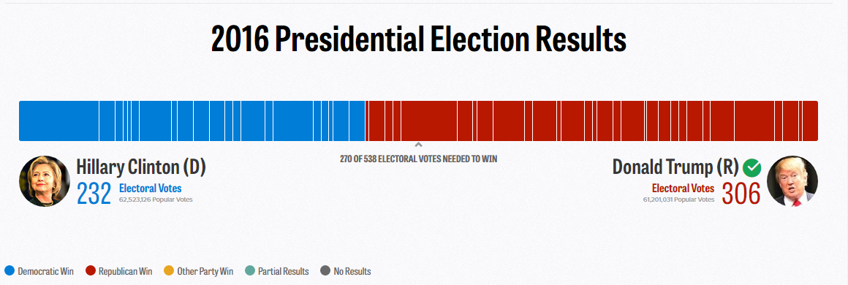
The White House
Graph from Politico.com

Slide 4
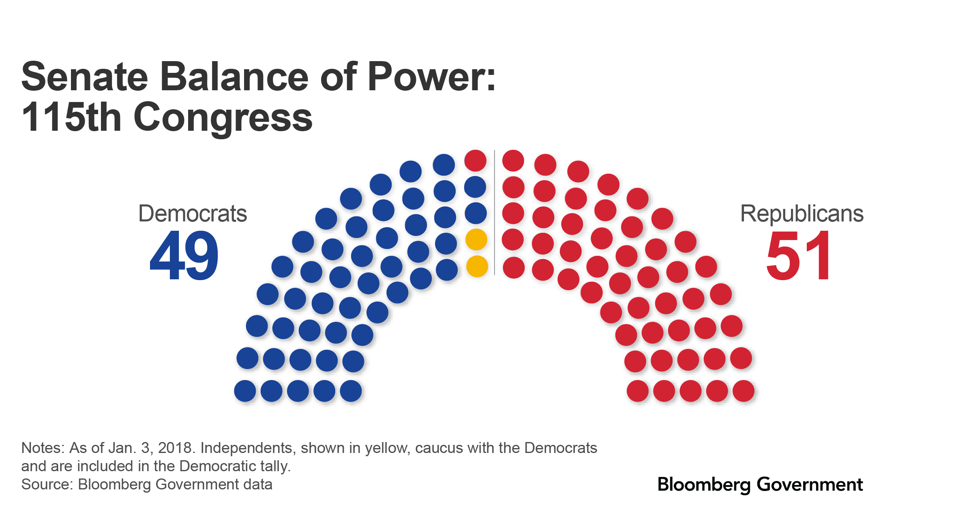
4

Slide 5
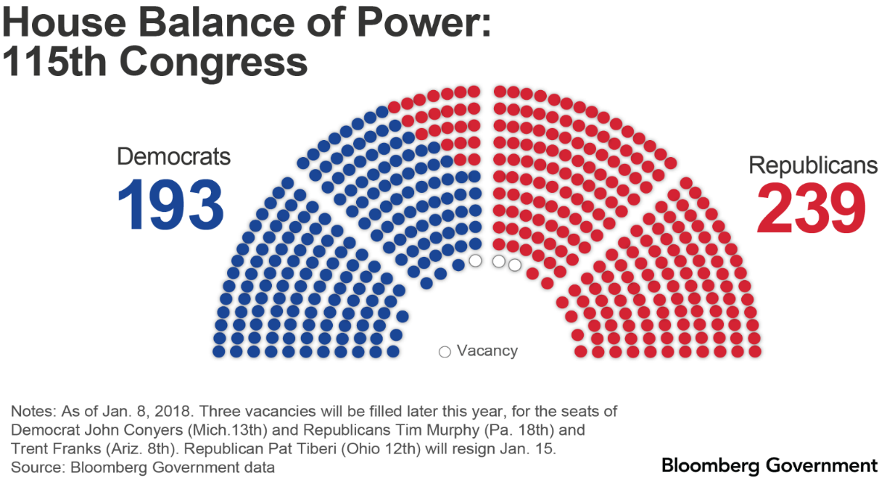
5

Slide 7
Trump Administration
Secretary of Transportation Elaine Chao
Dan Elwell, Acting Administrator As of Jan 7th, 2018
President & Airport Noise-Privatization

Slide 8
Relevant Committees
Senate Commerce Committee (Chair, John Thune, R-ND; Ranking Member Bill Nelson, D-FL)
Aviation, Operations , Safety and Security Subcommittee
Chair, Roy Blunt, R-MO; Ranking Member, Maria Cantwell, D-WA
House Transportation and Infrastructure Committee (Chair Bill Shuster, R-PA, Ranking Member Peter DeFazio, D-OR)
Aviation Subcommittee
Chair Frank A. LoBiondo, R-NJ Ranking Member, Rick Larsen, D-WA

Slide 9
Legislative Deadlines & Congressional Activity in 2018
Date | What to watch
Jan. 30 | State of the Union address
Feb. 5 | Statutory deadline for president’s fiscal 2019 budget request
Feb. 8 | Continuing resolution expires, including flood insurance patch
March 5 | Renewals for current DACA recipients end
March 31 | FAA authorization, community health center funding expire
Late March/early April | Extraordinary measures could run out if debt limit isn’t addressed*
July 30-Sept. 3 | House summer recess
Aug. 4-Sept. 3 | Senate summer recess
Sept. 30 | Expiration of farm bill, VAWA domestic violence programs, and emergency health preparedness authorities
Oct. 1 | Fiscal 2019 begins
Oct. 15-Nov. 12 | House election recess
Oct. 27-Nov. 12 | Senate election recess
Nov. 6 | Election Day
Nov. 13 | First day of congressional lame-duck session
Dec. 13 | Scheduled House adjournment
Dec. 14 | Scheduled Senate adjournment
December
*Though the debt limit was restored after Dec. 8, the Treasury Department can use extraordinary measures to finance operations. The Congressional Budget Office said Nov. 30 the department “will most likely run out of cash by late March or early April 2018.” Treasury Secretary Mnuchin reportedly requested an increase by Feb. 28.
Notes: DACA – Deferred Action for Childhood Arrivals; FAA – Federal Aviation Administration; VAWA – Violence Against Women Act
3

Slide 10
FY 2018 Budget Overview
February 9, 2018– The House and Senate passed a two-year budget agreement, which also included a Continuing Resolution to fund the government until March 23.
March 23, 2018– Both chambers are still required to pass either individual appropriations bills, an Omnibus, or another Continuing Resolution by March 23 in order to fund specific programs.
March 31st, FAA bill Extension Expires
October 1, 2018 – FY 2019 Begins

Slide 11
FAA Reauthorization
Currently Operating under an extension that expires March 31st, 2018
Previous multi-year bill expired in July of 2016
Senate Passed their version (S. 2658) in April of 2016, but it was never taken up by the House
Because of the difference in opinion regarding privatization and other policy issues as well as budget delays, a final bill was not passed

Slide 12
Legislation/Policy Initiatives/Trends
Airplane Impacts Mitigation (AIM) Act of 2017- HR 598
Introduced on 1/23/17 by Congressman Stephen Lynch (D-MA)
This bill requires the Federal Aviation Administration (FAA) to enter into an agreement with an eligible institution of higher education to conduct a study of the health impacts of airplane flights on residents exposed to a range of noise and air pollution levels from such flights.

Slide 13
Legislation/Policy Initiatives/Trends
Previous (114th Congress) Legislation
FAA Community Accountability Act of 2015 (H.R. 3965 )
Airspace Management Advisory Committee Act (S.2585)
Sound Insulation Flexibility Language in 2016 Transportation Appropriations Bill
CATEX Language (S. 2046/House FAA Bill Provision/Passed into law in 2016 in National Defense Authorization Act)

Slide 14
Legislation/Policy Initiatives/Trends
Noise Sections in 2016 FAA Bill:
Aircraft Noise Exposure: This section directs the FAA to conduct a review of the relationship between aircraft noise exposure and its effects on 13 communities around airports. (H)
Community Involvement Policy: This section directs the complete review of the Administration’s community involvement practices for Next Generation Air Transportation System (NextGen) projects. (H)
RNAV Departure Procedures: This section directs the FAA to consider the feasibility of dispersal of headings or other lateral track variations to address community noise concerns when proposing a RNAV departure procedures.
or amending an existing procedure that would direct aircraft between the surface and 6,000 feet above 5 ground level over noise sensitive areas.

Slide 15
QUIET SKIES CAUCUS
Established in 2014
Officially formed at the start of the 114th Congress, the Quiet Skies Caucus is a group of Congress Members dedicated to reducing the impact of aircraft noise on the communities they represent.

Slide 16
Upcoming events/opportunities
Quiet Skies Briefing
Wednesday March 14th Capitol Hill
N.O.I.S.E. November Meeting
Los Angeles California
N.O.I.S.E. Webinars

Slide 17
Questions???
N.O.I.S.E.
415 2nd Street NE
Suite 210
Washington, D.C. 20002
(202) 544-9896
aviation-noise.org

