Slide 1
FAA Enhanced Community Involvement
Presented to: Airport Noise HELP Symposium
By: Leeann Hart
    Community Involvement Specialist for Airspace Projects
Date: March 12, 2018

Slide 2
Outline
Need for and purpose of FAA’s airspace changes
How we work with airports and stakeholders to ensure we engage with the communities
  Best practices
  FAA culture change
  Community involvement activities

Slide 3
Bottom Line Up Front
We know there are community concerns, we care about them and are taking action… and we want to work with you and your airports to address the concerns of communities

Slide 4
Why does FAA make airspace changes?
FAA’s mission is to maintain safety and efficiency of National Airspace System in the face of major growth in air traffic
  “Efficiency”
Airspace designs are based on safely and efficiently flowing traffic in and out of busy airports

Slide 5
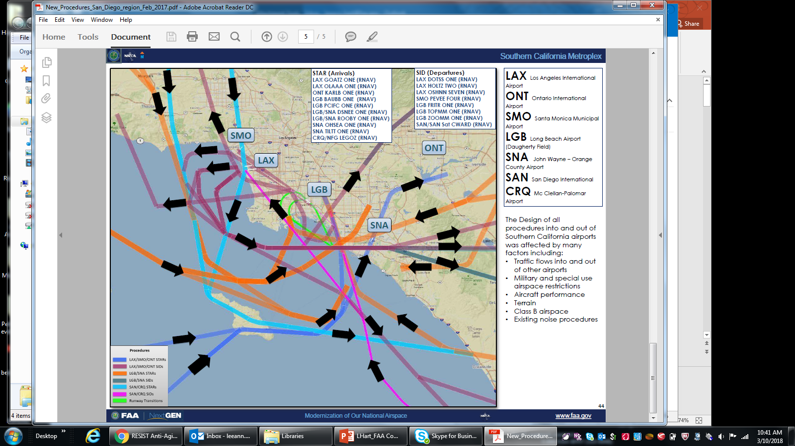
Airspace Challenges

Slide 6
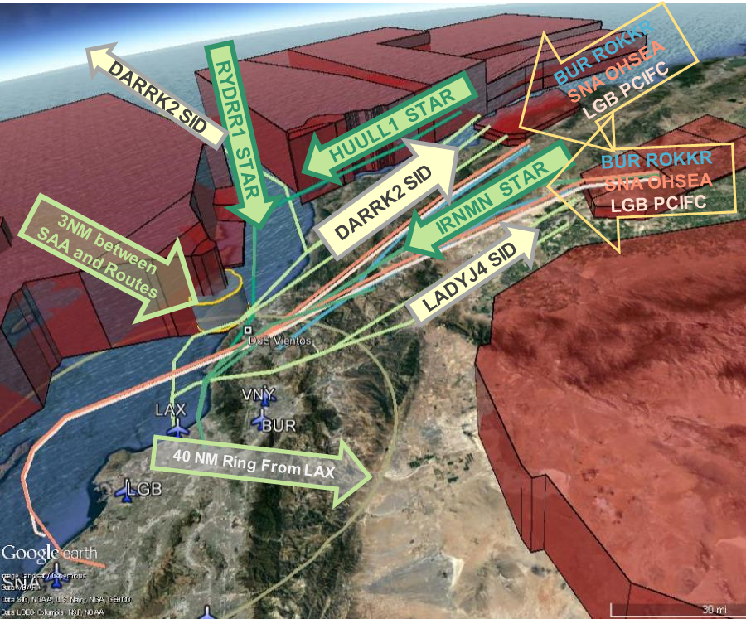
Traffic Flows
In and Out of LA Area
Dark red areas are military Special Activity Airspace that must be avoided while transitioning into/out of the LA basin

Slide 7
Why does FAA make airspace changes?
FAA’s mission is to maintain safety and efficiency of National Airspace System in the face of major growth in air traffic
  Efficiency
  Airspace designs are based on safely and efficiently flowing traffic in and out of busy airports
Vital to city’s airport and NAS as a whole
Aviation is important to our economy and your city; airports contributed $73 billion in total output to the U.S. economy in 2012
Update the NAS in the same way localities upgrade ground transportation
Need to keep the system viable and resilient to keep our cities connected
Purpose and need drive airspace changes; rooted in safety and efficiency
We know we have to be more attuned to local community feedback
Atmosphere for implementing airspace projects has evolved since the FAA began to integrate PBN into the NAS
Similarly, our community involvement practices have evolved

Slide 8

ATO Enhanced Community Involvement:
Recent Best Practices
* Will vary based on * project circumstances
Enhanced partnerships with airport and industry stakeholders
Earlier and more frequent engagement with local officials and the public
  Continued engagement with community roundtables to discuss issues & solutions
  Public workshops and webinars
Enhanced outreach strategies: public workshops, targeted community meetings, internet and technology tools (e.g., webinars, websites), social media, traditional media
Visualizations to convey locations of procedural changes relative to local landmarks
Videos to explain more complex procedures and address areas of public concerns
Interactive noise maps to correlate noise levels with geographic locations
Design refinements based on community input

Slide 9

Ongoing Culture Change Regarding Community Involvement
Since 2016 we have been transforming the FAA and ATO community involvement strategy and practices
  Updated and enhanced policies
Organizational enhancements
A comprehensive and strategic approach to community involvement efforts is central to this transformation
Development of
internal guidance
Putting it into practice
Other internal guidance is under development

Slide 10
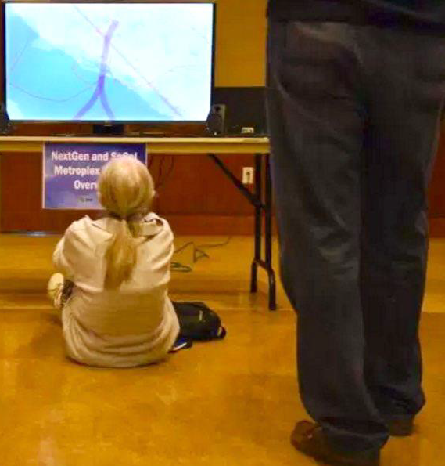
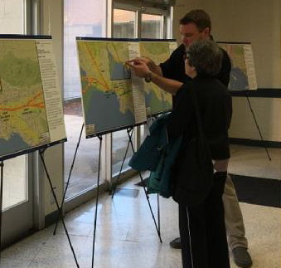
PBN Aviation & Community Involvement
Key Decisions and Activities
Project Initiation Decision
Design Kickoff
Decision
Development Decision
Implementation
Decision
Preliminary
Activities
Design
Activities
Development and Operational Preparations
Implement-ation
Post-Implementation
Elected/Other Official, Airport, Airline, and Community Involvement Opportunities
The need for and level of involvement will vary based on project circumstances

Slide 11
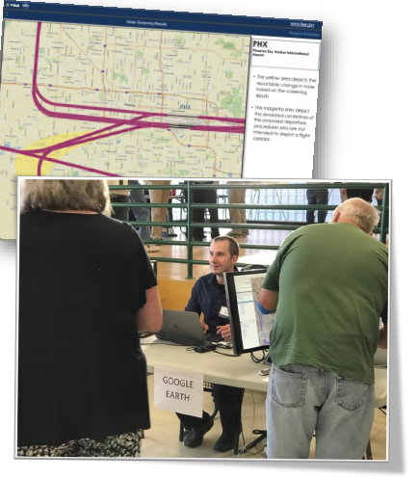
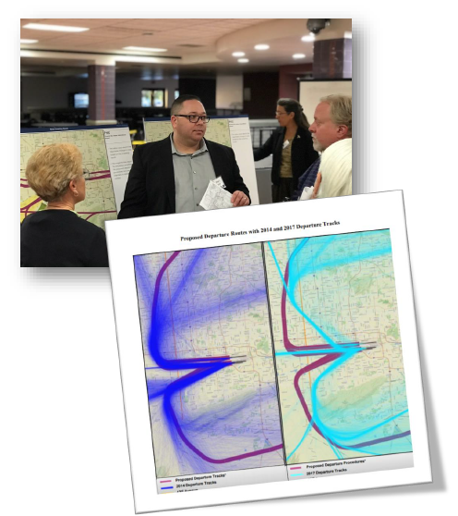
Public Workshops

Slide 12
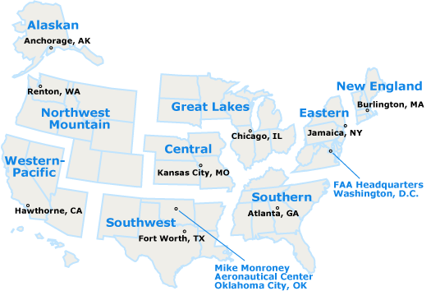
FAA Regional Offices

Slide 13
The FAA’s Commitment to Community Involvement
Our national aviation system is a vital transportation network connecting people and goods across the country and to other parts of the world. Building on a proud history of innovation in aviation, the Federal Aviation Administration (FAA) is now engaged in transforming the system to meet 21st century air travel needs. As we carry out our mission to provide the safest, most efficient aerospace system in the world, we are accountable to the American public.
FAA Community Involvement Manual 2016
The views of communities—including local residents, the general public, and stakeholders—are important to the FAA as we take the next steps to advance the national aviation system. This update to the FAA’s Community Involvement Manual reaffirms our commitment to inform and involve the public and to give meaningful consideration to community concerns and views as the FAA makes aviation decisions that affect them.
http://www.faa.gov/nextgen/communityengagement/

Slide 14
Summary
FAA makes airspace changes based on purpose and need
Growing communities upgrade their infrastructure
We are working with your airports and stakeholders in your communities to make important improvements to the airspace system
We’ll work with your political leadership, your airports, your roundtables to be successful for your community

Slide 15
Thank you

